Slide 1
J’s music studio website
Jericho M.Gane
BSIT-3C

Slide 2
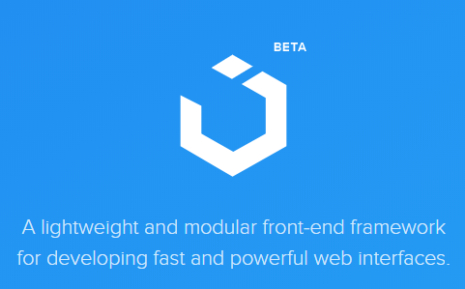
CSS framework
UiKit v3
A lightweight and modular front-end framework for developing fast and powerful web interfaces

Slide 3

Header Files

Slide 4

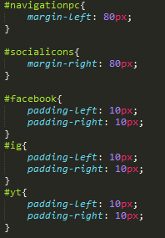
Desktop Navbar

Slide 5
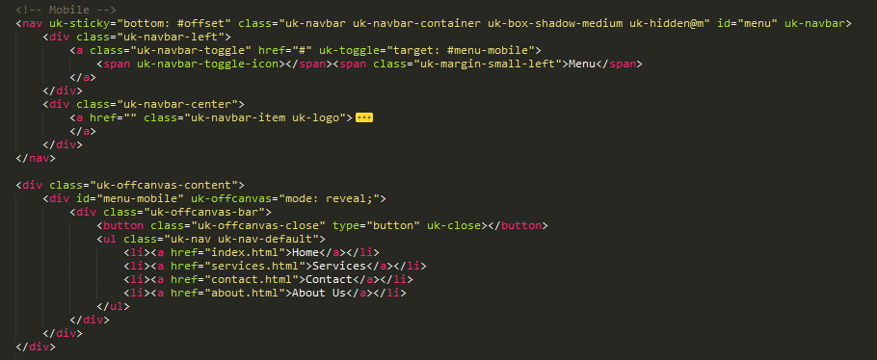

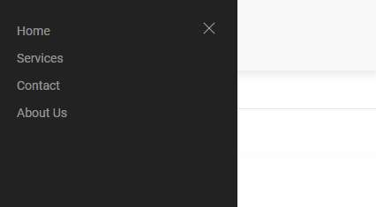
Mobile Navbar

Slide 6
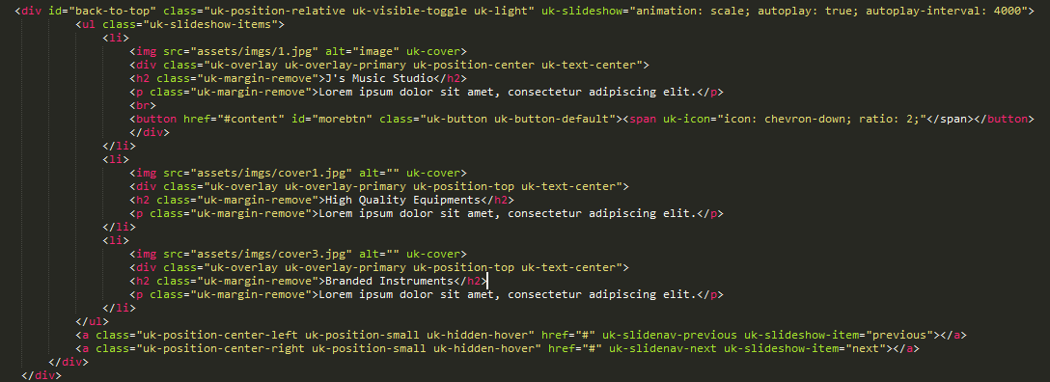
Slideshow

Slide 7
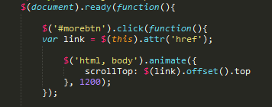
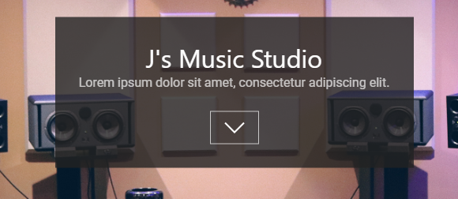
Scroll Down Button

Slide 8
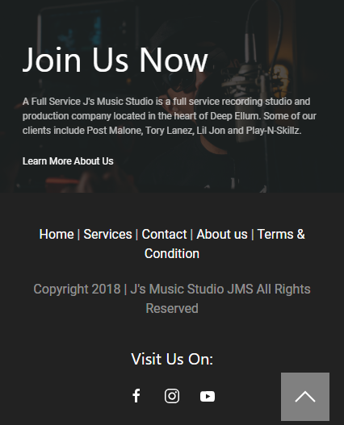
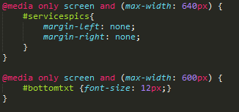

Media Query

Slide 9
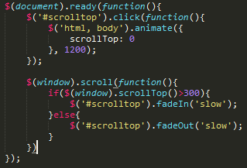

Scroll to top button

Slide 10


UiKit Cards

Slide 11
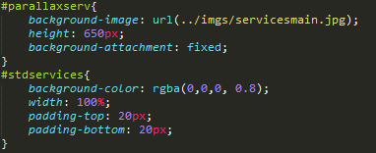
Parallax Effect

Slide 12
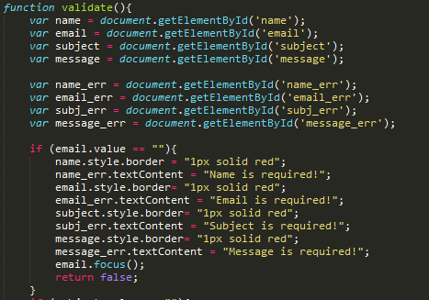


Empty Form Validation

Slide 13

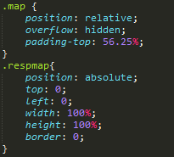
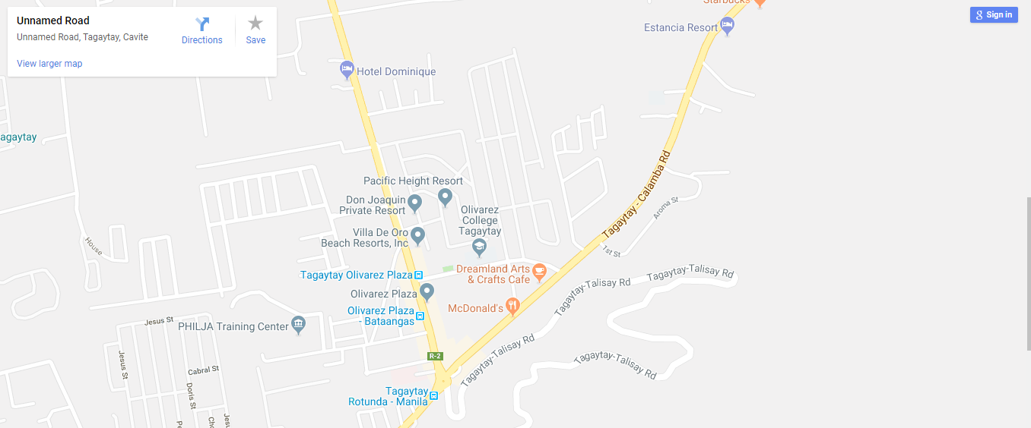
Google maps

Slide 14

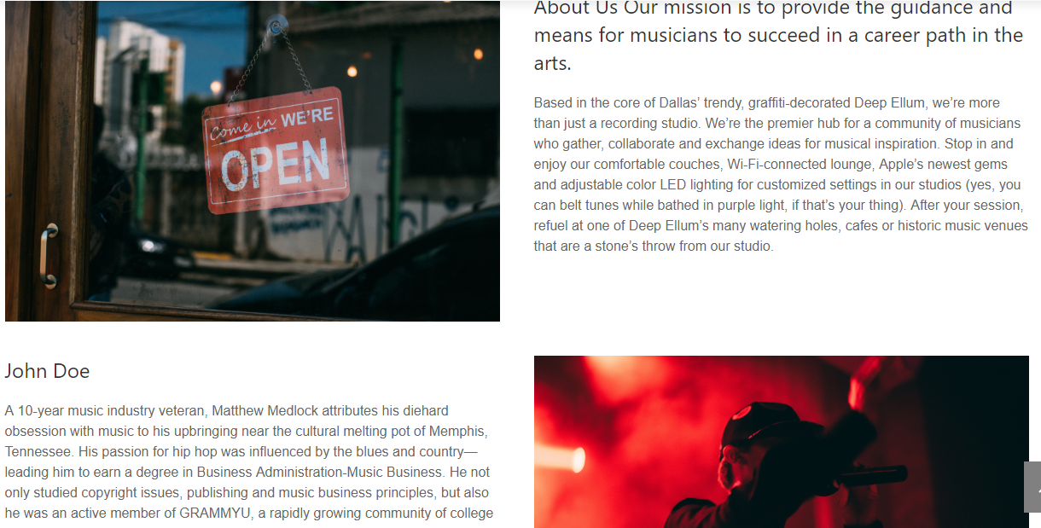
UiKit Grid

Slide 15

Footer

Slide 16
Thank You

